Slide 1

Team Remote Excavator
Alec Boyce, Ryan Fortier, Davis Geniza, Oscar Nunez, Zhiyu Wang

Slide 2
Project Description
The purpose of project is to make a remote-control excavator
Engineering requirements description:
  a fully electric, remotely operated, small scale excavator
Client
  The excavator can dig a trench that is a foot in depth and six inches in width
  The batteries should be able to operate for a full workday

Slide 3
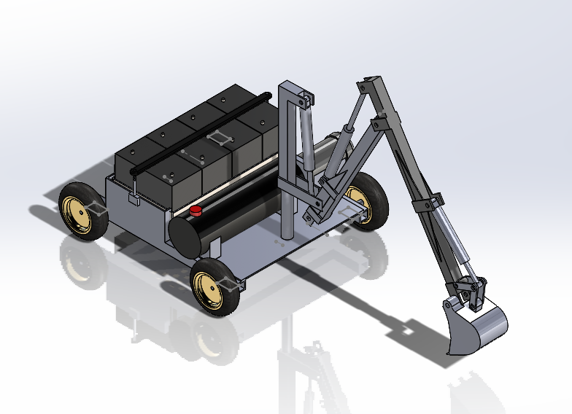

Design Description
Base dimensions: 30”W, 40”L
Arm dimensions: Tower 30”, Boom 30”,Dipper 36”, Bucket 6.5” x 11”
3 Ram system
Hydraulic pump output of 1.5 horsepower

Slide 4
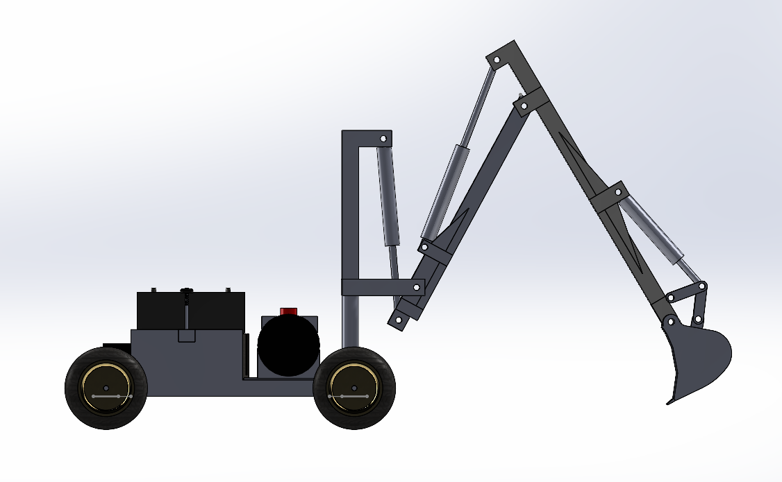
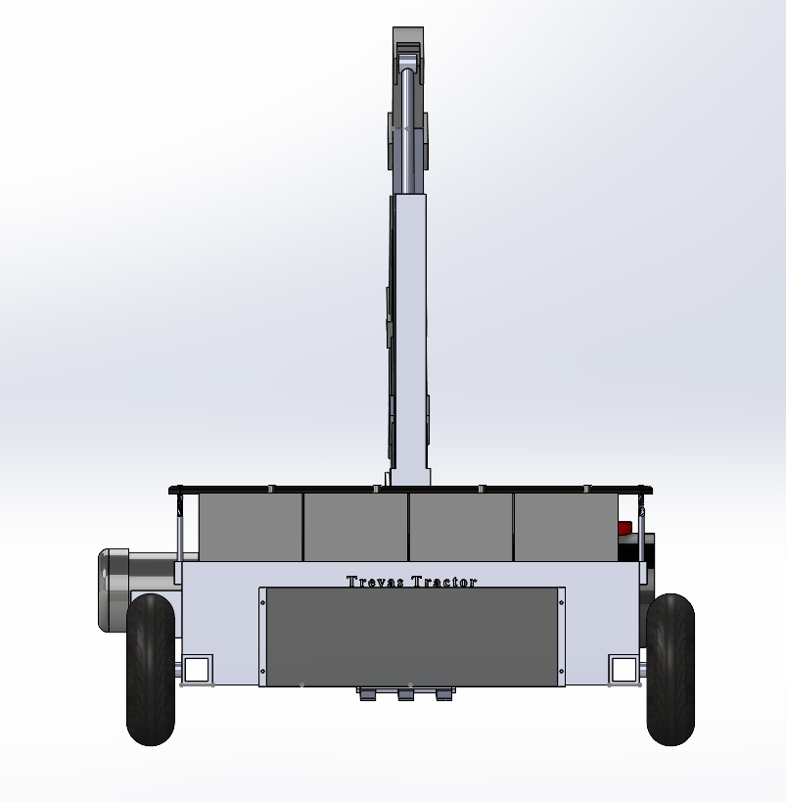
Design Description
Continued
Power inverter attached to battery box
4 batteries in series
10” wheels
2 Rams with 24” stroke length
1 Ram with 18” stroke length
2 motors
Nicknamed “Trevas Tractor”

Slide 5
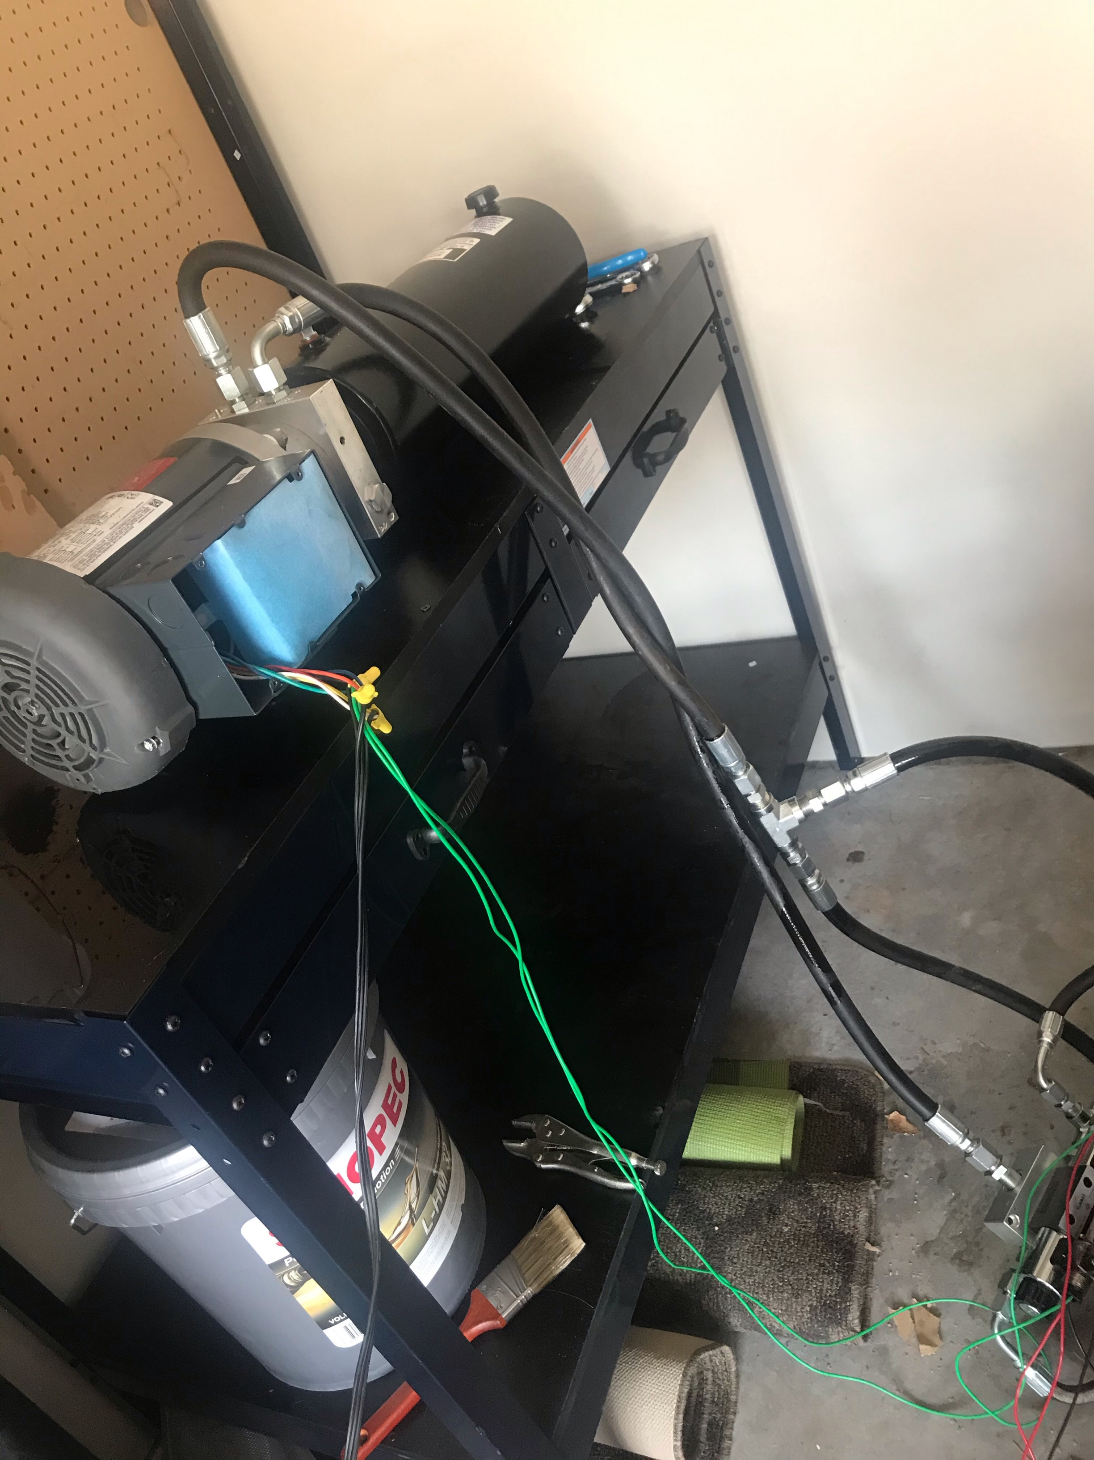
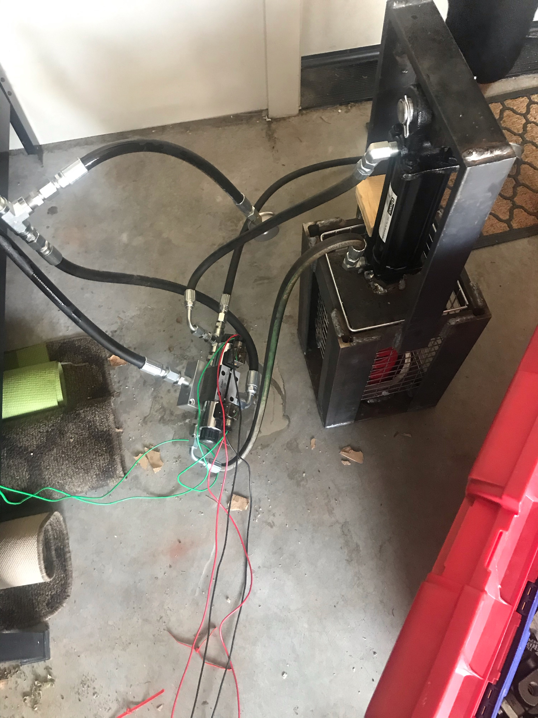
Current State: System
Hydraulics assembled and tested for functionality.
Wired electrical components for hydraulics and ram components.
Added hydraulic fluid.
Hydraulic thread sealer to prevent leaking of hydraulic system.
Welded battery box.

Slide 6
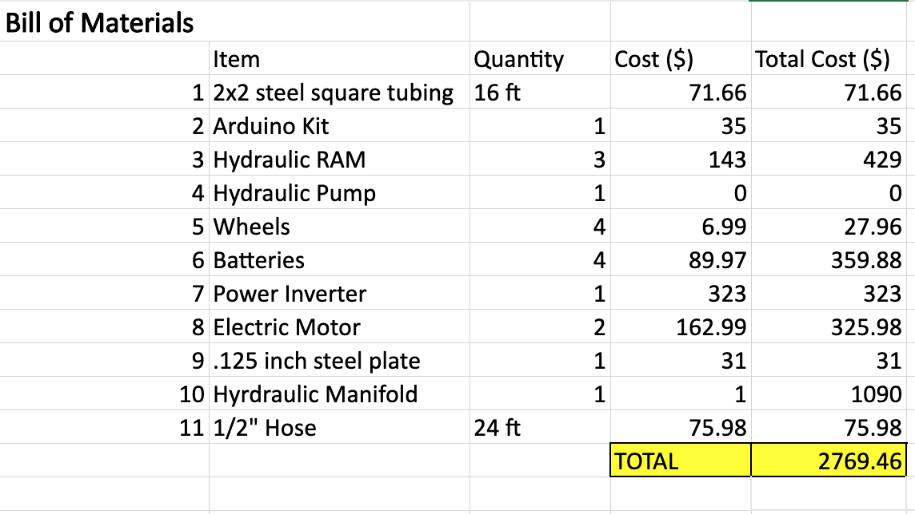
Current State: BOM
Bill of materials consists of important items purchased and unpurchased.
Budget was approx $1000 dollars.
Cost calculated from quantity values and prices researched online.

Slide 7
Current State: To do list items
Website (Zhiyu)
Cad design and assembly (Ryan, Davis, Alec)
Force calculations (Oscar)
Implementation of design (Team Effort)
QFD (Davis)
Arduino Coding (Davis)
Welding of steel components (Ryan, Alec)
Project research (Team Effort)

Slide 8
Implementation Plan - Oscar
Final Product Design
Final CAD Package
Final Force Calculations
Arduino Code Implementation
Manufacturing Plan
Fully Assemble
Cut sheet metal into proper dimensions
Weld components
Hydraulic Tubing layout

Slide 9
Testing Plan - Davis
Completed Tests: Arduino remote operated motors, hydraulic ram functionality, manufacturing.
Remaining Hardware Tests: Arduino operated hydraulic testing, powered by the inverter and batteries.
Final Product Testing: Utilizing the excavator to dig a trench, 5' in length, 1' deep, and 6" wide.
Successful testing will prove that the final product can be remotely operated, electrically powered, and able to dig an irrigation trench.
Final test will require an area with plenty of room and moveable soil. Ideal location being the compost fields, South Campus.

